Slide 1

Defining Scope, Quality, Responsibility and Activity Sequence

Slide 2
Chapter Concepts
Clearly defining the project objective
Preparing a project scope document
Understanding the importance of planning for quality
Creating a work breakdown structure
Assigning responsibility for work items
Defining specific activities
Creating a network diagram
Utilising a project management methodology called the systems development life cycle for information systems development projects

Slide 3
Learning Outcomes
Establish a clear project objective
Prepare a project scope document
Discuss the importance and elements of a project quality plan
Develop a work breakdown structure
Prepare a responsibility assignment matrix
Describe how to define specific activities
Create a network diagram

Slide 4
Project Integration Management Project Scope Management Project Quality Management Project Time Management
Project Management Knowledge Areas from PMBOK® Guide

Slide 5
Establish Project Objective
Planning process is based on the project objective
Establishes what is to be achieved
Often stated in the project charter or RFP
Is the tangible end product
Project objective includes
Expected benefits
Primary project end product or deliverable
Date required to be completed
Budget
Changes agreed upon by customer and contractor

Slide 6
Define Project Scope
Project scope
Project scope document
Defines what needs to be done
Includes
Items contained in project charter, RFP, proposal
More detail
Establishes common understanding of scope with stakeholders
Usually contains
Customer requirements
Statement of Work
Deliverables
Acceptance criteria
Work Breakdown Structure
Establishes baseline
Change control system to avoid scope creep

Slide 7
Plan for Quality
Complete work according to specifications and standards
Plan for assuring quality as project progresses
Include
References for specifications and standards
Written procedures for quality tools and techniques
Key aspects
Monitor as the project progresses
Do work right the first time rather than rework

Slide 8
Create Work Breakdown Structure
Deliverable-oriented hierarchical decomposition
Organise project work and deliverables
Create logical groupings
Subdivide into more manageable components
Deliverable is output of work package
Resource requirements and durations can be assigned
Accountability can be assigned
Project manager can monitor and control
Graphic chart or indentured list

Slide 9
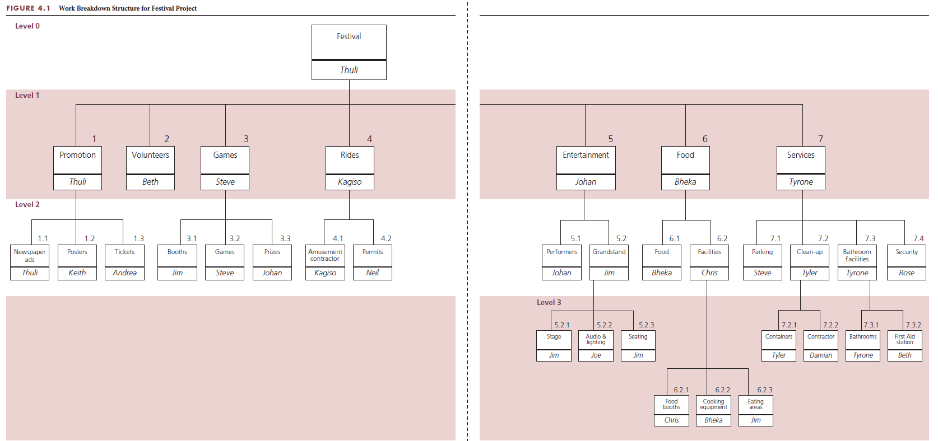
WBS with breakdown to different levels

Slide 10
WBS with breakdown to different levels

Slide 11
WBS with breakdown to different levels

Slide 12
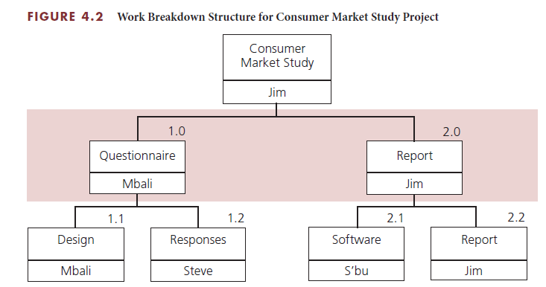
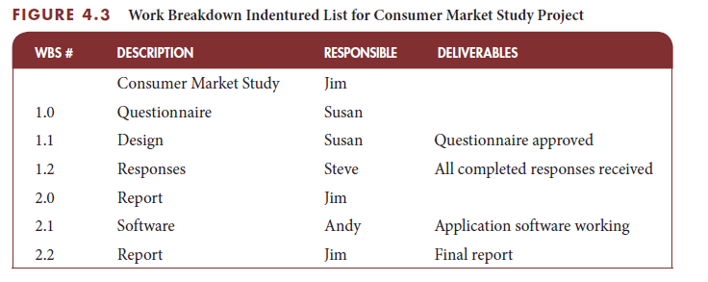
WBS
Graphic Chart
Indentured List

Slide 13
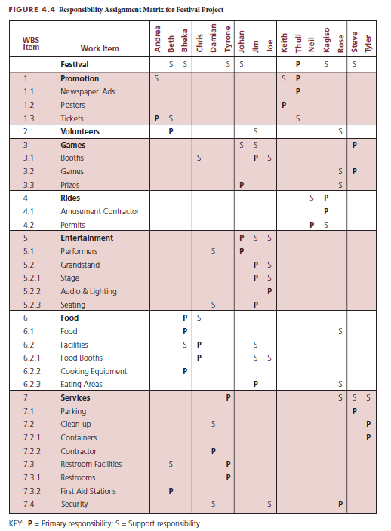
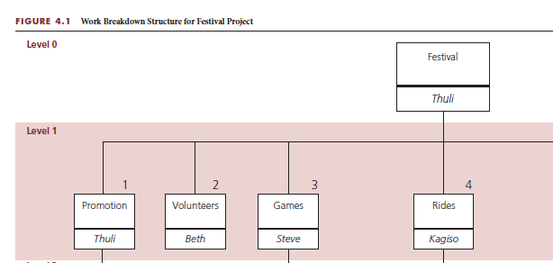
Assign Responsibility
Responsibility assignment matrix
Designate responsible individuals
P = Primary responsibility
S = Support responsibility
Associates responsibility
For each work item
For each individual
Only one primary per work item

Slide 14
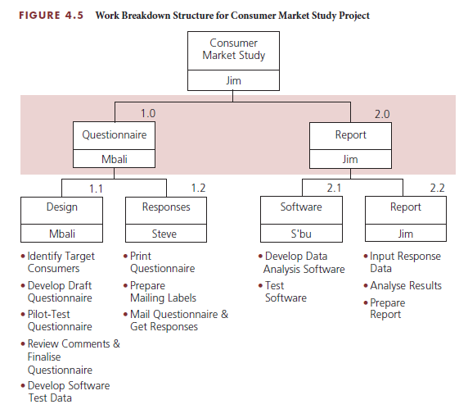
Define Activities
Responsible resources define activities
Breakdown work packages to work items
Level needed to perform deliverable
May not be able to define all
Comprehensive activity list
Not always require expenditure of effort
Could be wait time

Slide 15
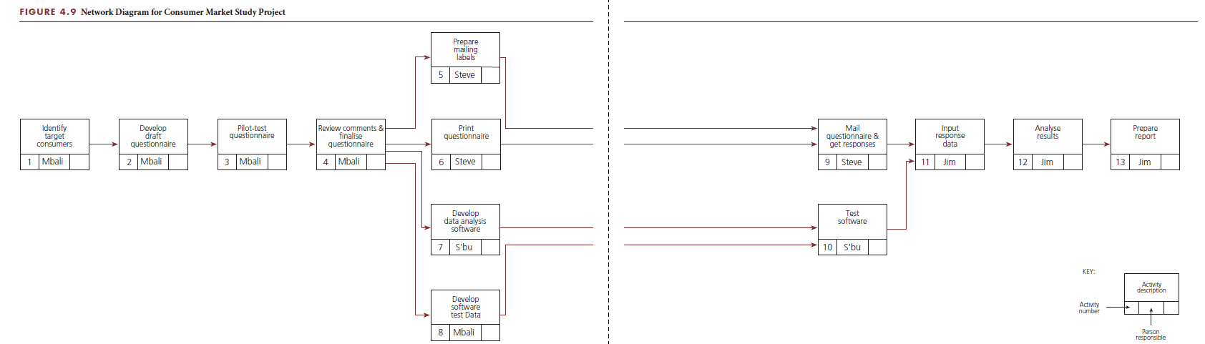
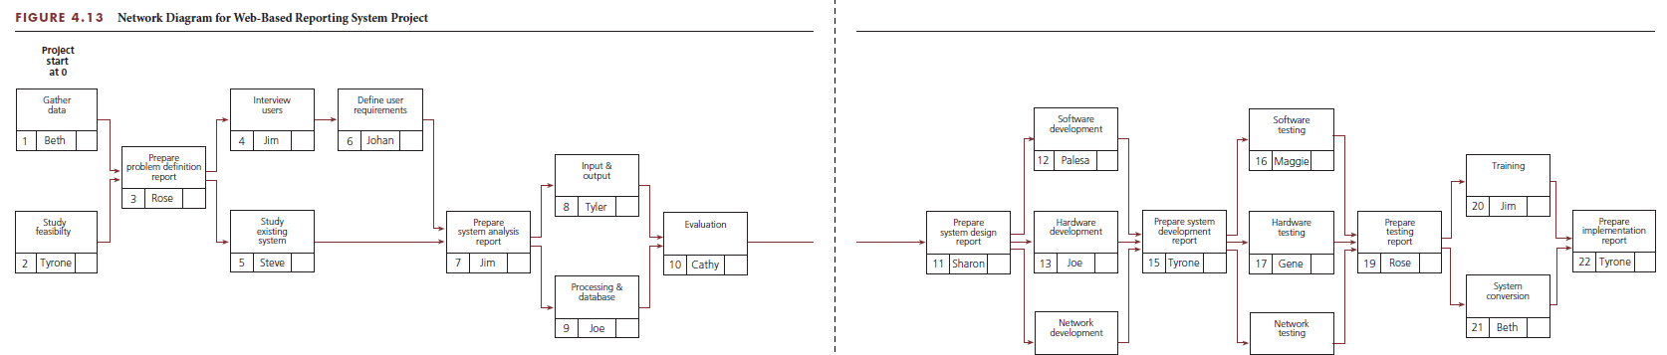
Sequence Activities
Network diagram
Defines the sequence of activities and relationships
Tool for arranging order
Common techniques
PERT
CPM
PDM

Slide 16

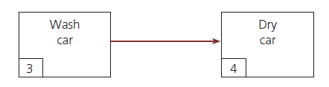
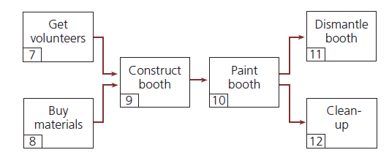
Network principles
Activities
Represented by a box
Consume time
Described by verb
Relationships
Linked in serial sequence
Complete concurrently

Slide 17
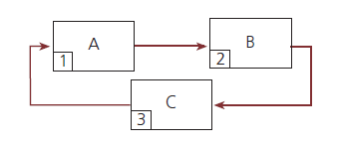
Loops
Illogical relationship among activities
Perpetually repeats itself
Not acceptable

Slide 18
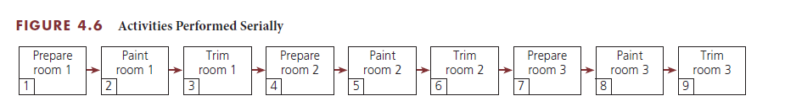
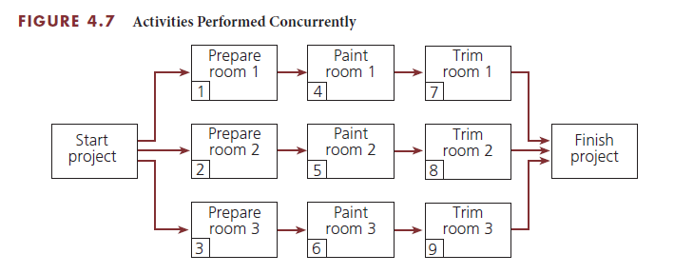
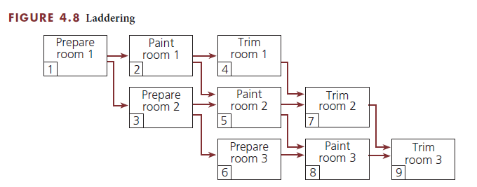
Laddering
Set of repeating activities
Serial sequence
One work
Two wait
Can be performed at same time
Would need triple resources
Ladder activities
Allow for shortest possible time for completion
Best use of the three workers and experts

Slide 19
Create network diagram
Tips and techniques
Development of diagram
Logical sequence of activities
Show dependent relationships
Elaborate as project progresses
Use subnetworks for similar activity sequences and relationships
Questions to answer
Finish before next start?
Done concurrently?
Cannot be started next?
Guidelines for detail level
Define each work package
Draw summary level network then add detail
Detail to responsibility or deliverable change
Duration less than project progress review

Slide 20
Planning for Information Systems Development
Definition
Process
Computer-based system
Accepts data as input
Processes the data
Produces useful information
Examples
Computerised order entry
E-commerce
Automatic teller machines
Billing, payroll, and inventory
Plan, execute, and control
Systems development life cycle
Problem definition
System analysis
System design
System development
System testing
System implementation

Slide 21
An IS example: Internet applications development for Ukudala Office Designs
Ukudala Office Designs
Project
Large number of sales representatives
Sell office furniture to major companies
State assignments in four regions
Management monitor state and regional sales
Build web-based IS system to track prices, inventory, and competition
Project manager identified
WBS follows SDLC
Responsibility assignment matrix completed
List of tasks compiled and predecessors identified
Network diagram created

Slide 22
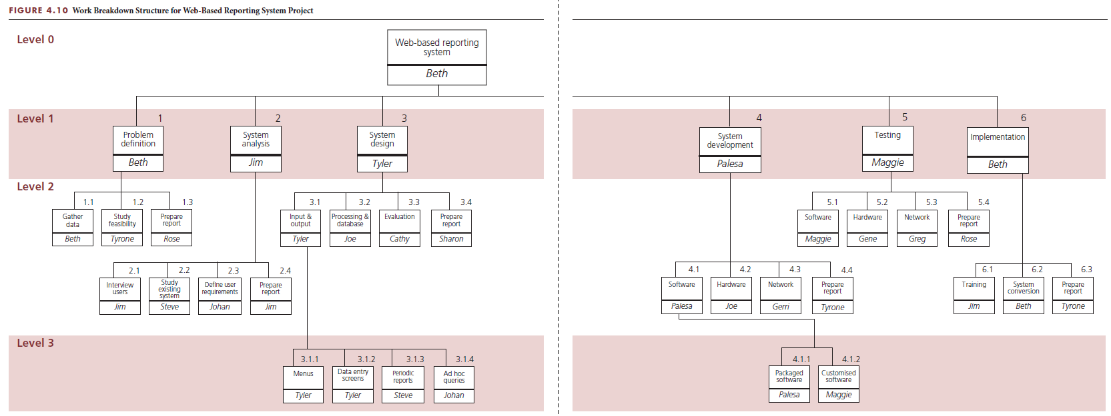
IS example: WBS follows SDLC

Slide 23
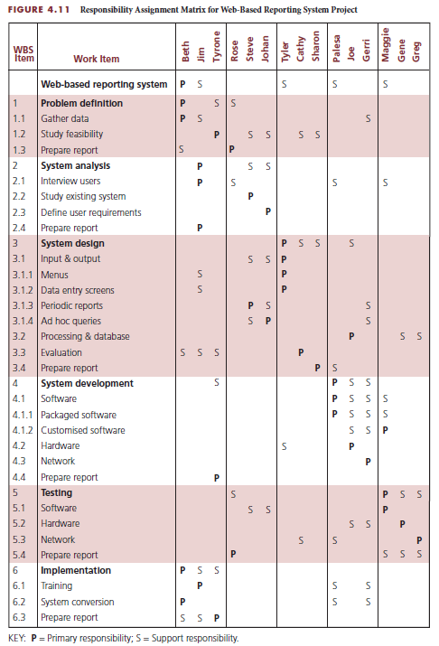
IS example: responsibility assignment matrix

Slide 24
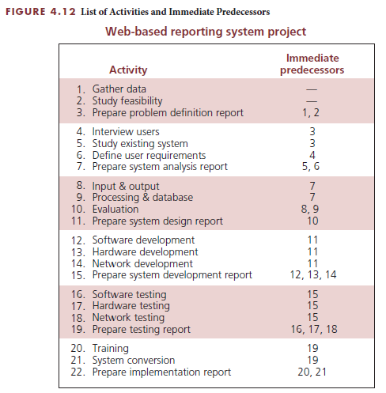
IS example: task list and predecessors

Slide 25
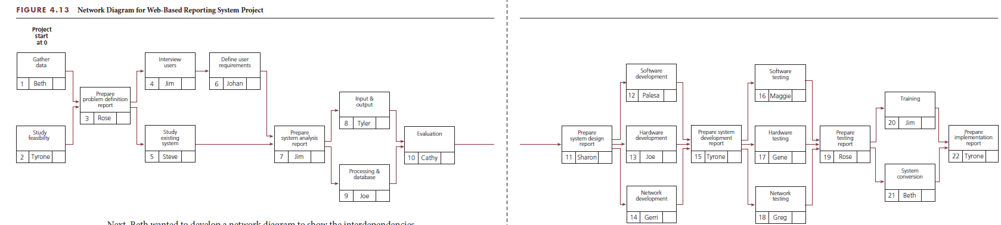
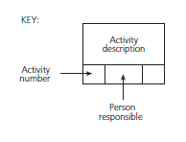
IS example: network diagram

Slide 26
Project Management Information Systems
Wide variety of systems available
Plan and control projects in interactive mode
Plan and test different options
Create reports, diagrams, and charts
Interface with other software applications
Appendix A has additional information

Slide 27
Critical Success Factors
Plan the work and then work the plan. It is important to develop a plan before starting to perform the project. Taking the time to develop a well-thought-out plan is critical to the successful achievement of any project.
Participation builds commitment. By participating in the planning of the work, individuals will become committed to achieving it according to the plan.
The project must have a clear objective of what is to be achieved. The objective should be defined in terms of end product or deliverable, schedule, and budget, and it must be agreed upon by the customer and the project team that will perform the project.
The project scope document is valuable for establishing a common understanding and agreement among project stakeholders regarding the scope of the project.
Having a quality plan at the outset of the project is extremely beneficial because it will help prevent incurring additional costs and schedule extensions due to rework caused by work and deliverables that fail to meet quality requirements and customer expectations.
The key to quality control is to monitor the quality of the work early and regularly throughout the performance of the project, rather than waiting until all the work is completed before checking or inspecting for quality.
The network diagram is also is a communication tool for the project team because it shows who is responsible for each activity and how each person’s work fits into the overall project.

Slide 28
Summary
The planning process is based on the project objective, which establishes what is to be achieved.
The project scope defines what needs to be done.
The project scope document usually contains the customer requirements, statement of work, deliverables, acceptance criteria, and a work breakdown structure.
The quality plan must include or reference the specifications, industry or government standards, and codes that must be used and met during the performance of the project work.
The work breakdown structure establishes the framework for how the work will get done to produce the project deliverables.
A responsibility assignment matrix defines who will be responsible for the work.
Activities define more specifically how the work will get done.
A network diagram defines the sequence of how and when the activities will be performed.
Project planning is a critical activity in developing an information system (IS).
A project management planning tool or methodology, called the systems development life cycle (SDLC), is often used to help plan, execute, and control IS development projects.
Numerous project management information systems are available to help project managers plan, track, and control projects in a completely interactive way.

